Slide 1
Ensembles
Part 2 – Boosting
Geoff Hulten

Slide 2
Ensemble Overview
Bias / Variance challenges
  Simple models can’t represent complex concepts (bias)
  Complex models can overfit noise and small deltas in data (variance)
Instead of learning one model, learn several (many) and combine them
  Easy (low risk) way to mitigate some bias / variance problems
  Often results in better accuracy, sometimes significantly better

Slide 3
Approaches to Ensembles
Learn the concept many different ways and combine
  Prefers higher variance, relatively low bias base models
  Models are independent
  Robust vs overfitting
  Techniques: Bagging, Random Forests, Stacking
Learn different parts of the concept with different models and combine
  Can work with high bias base models (weak learners) and high variance
  Each model depends on previous models
  May overfit
  Techniques: Boosting, Gradient Boosting Machines (GBM)

Slide 4













Another Ensemble Example
High Bias; Low Variance
Accuracy 92.7%
Accuracy 91.4%
Accuracy 92.1%
Accuracy 92.4%
Average 10 Linear Models
Accuracy 92.5%
Target Concept
Linear Models
Accuracy 92.3%
Accuracy 92.1%
Accuracy 92.1%
Average 100 Linear Models
Accuracy 92.4%
Accuracy 92.6%
Accuracy 92.1%
100 samples per model, iterations=10k, step=0.05
Average 500 Linear Models

Slide 5
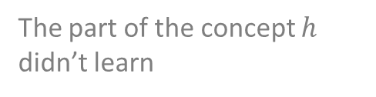
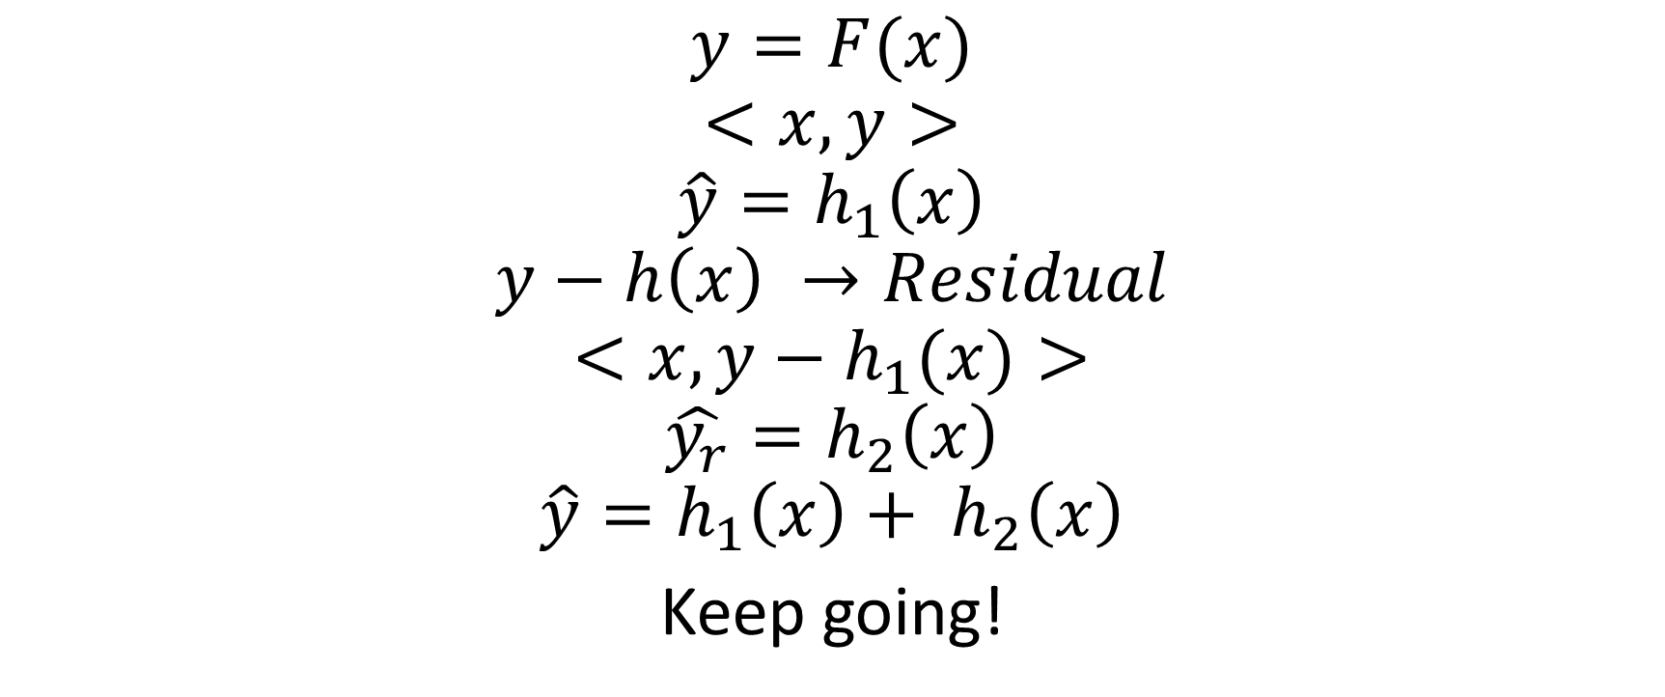
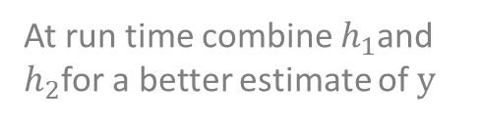
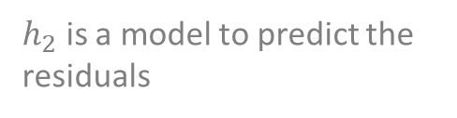
Boosting Concept
Concept we’re trying to learn
Training Data
$$y=F(x)$$
$$<x, y>$$
$$\hat{y}=h_{1}\left(x\right)$$
$$y−h\left(x\right) →Residual$$
$$<x, y−h_{1}(x)>$$
$$\hat{y_{r}}=h_{2}\left(x\right)$$
$$\hat{y}={h_{1}\left(x\right)+ h}_{2}\left(x\right)$$
Keep going!
Model we learn on data
The part of the concept $h$ didn’t learn
Training data to learn the residual
$h_{2}$ is a model to predict the residuals
At run time combine $h_{1}$and $h_{2}$for a better estimate of $y$

Slide 6




Boosting Sketch
Each model trained on mistakes (residuals) from previous runs
Models must be trained in sequence (parallel not possible)
Training
Set
Linear Model
Reweighted
Training
Set
Linear Model
Reweighted
Training
Set
Linear Model
Reweighted
Training
Set
Later models target hard samples and noise
(overfit)
Conceptual Boosting
Learn Base Model
Reweight training data so mistakes get more focus
Learn Another Base Model
Stop when starting to overfit (holdout set?)
Final Answer is weighted vote of all models
Linear Model
Ensemble Prediction

Slide 7
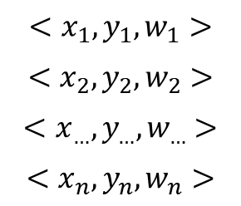
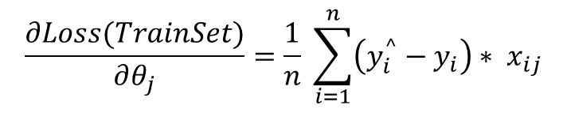
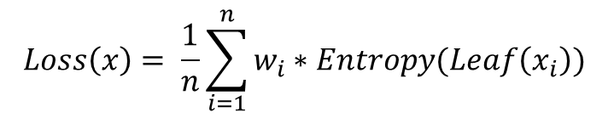
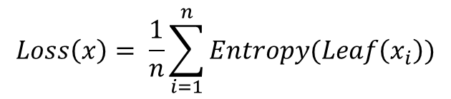
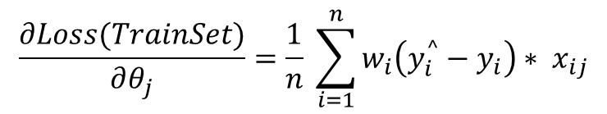
Reweighting Training Data
Logistic Regression:
$$\frac{∂Loss(TrainSet)}{∂θ_{j}}=\frac{1}{n} \sum_{i=1}^{n}{\left(y_{i}^{^}−y_{i}\right)∗ x_{ij}}$$
labels
features
weights
$$\frac{∂Loss(TrainSet)}{∂θ_{j}}=\frac{1}{n} \sum_{i=1}^{n}{w_{i}\left(y_{i}^{^}−y_{i}\right)∗ x_{ij}}$$
$$<x_{1},y_{1},w_{1}>$$
$$<x_{2},y_{2},w_{2}>$$
$$<x_{…},y_{…},w_{…}>$$
$$<x_{n},y_{n},w_{n}>$$
$$Loss\left(x\right)= \frac{1}{n}\sum_{i=1}^{n}{Entropy(Leaf\left(x_{i}\right))}$$
Decision Trees:
Similar in entropy
calculation…
$$Loss\left(x\right)= \frac{1}{n}\sum_{i=1}^{n}{w_{i}∗Entropy(Leaf\left(x_{i}\right))}$$

Slide 8
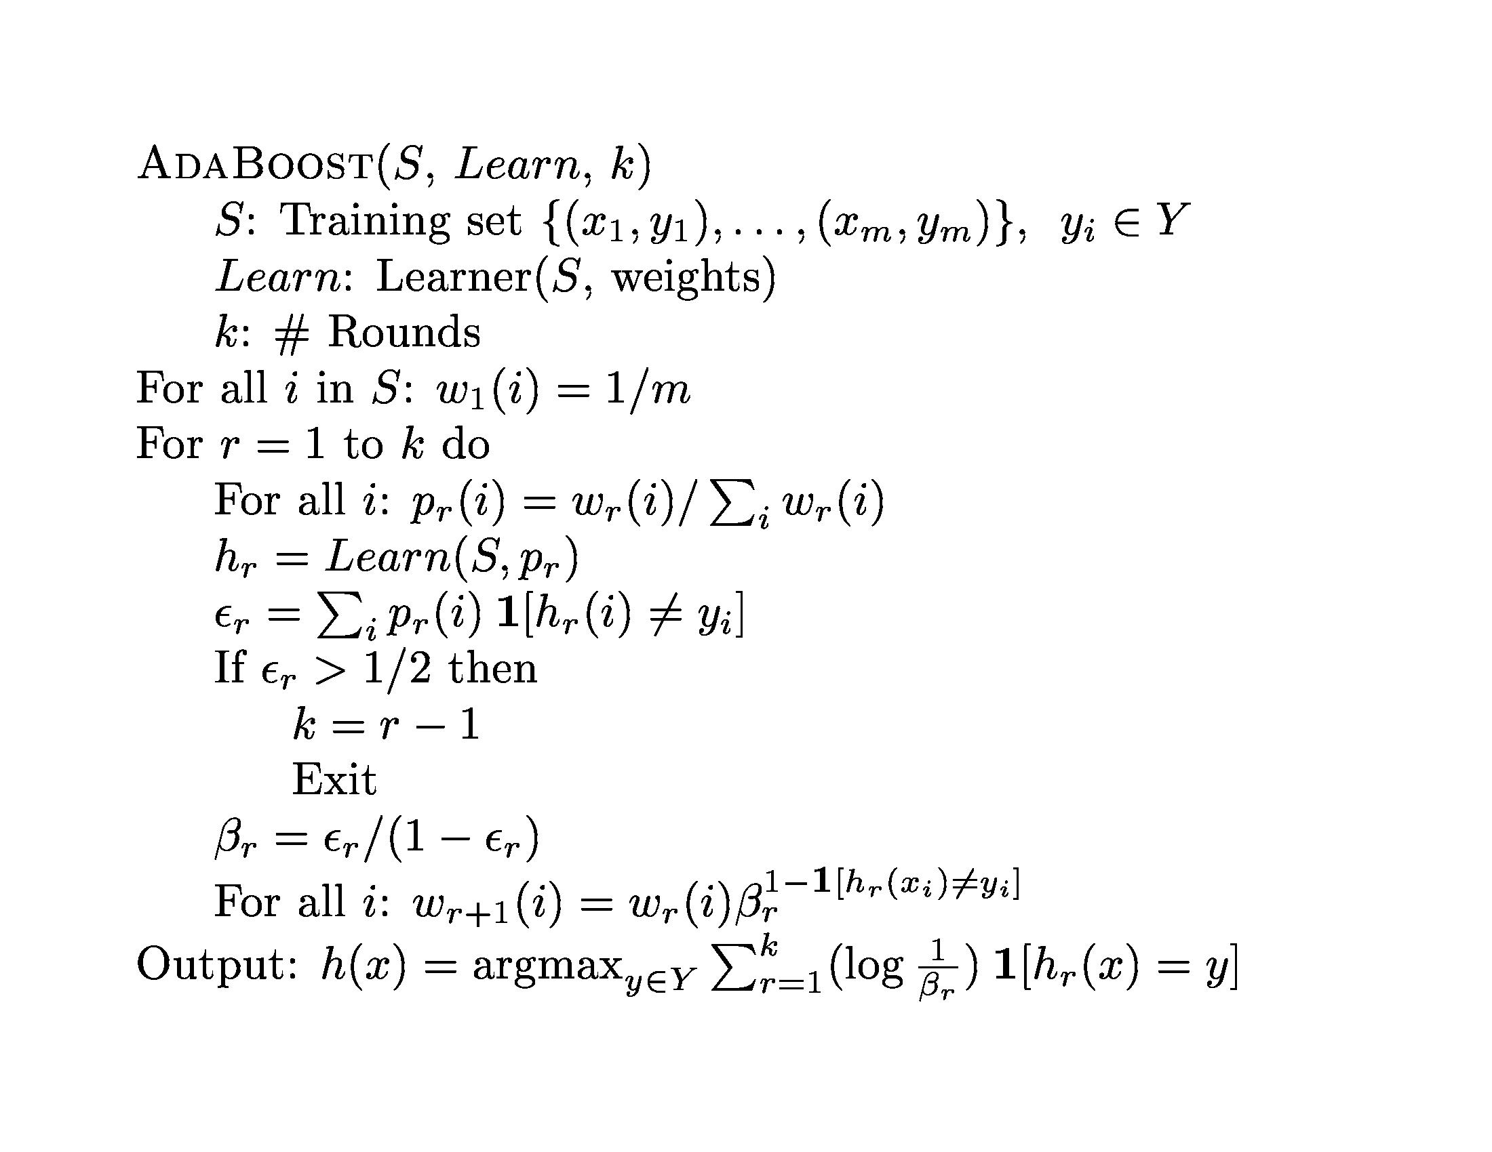

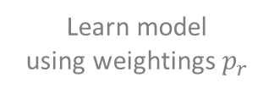
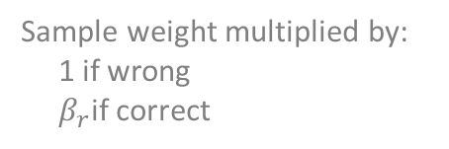



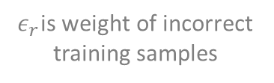

AdaBoost Algorithm
Normalize training set weight (sum to 1)
$B_{r}$is error of model $r$
Samples start with
uniform weight
$$β_{r}$$
$$ε_{r}$$
r: round
k: numModels
Learn model
using weightings $p_{r}$
Sample weight multiplied by:
1 if wrong
$β_{r}$if correct
$ε_{r}$is weight of incorrect training samples
Final ensemble, each model votes based on accuracy
High training error means residuals too hard (noisy) to make progress so stop
$$log⁡(\frac{1}{β_{r}})$$
$$β_{r}$$

Slide 9


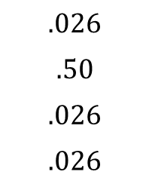

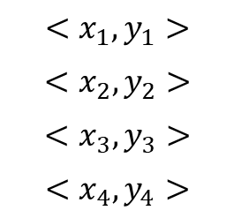


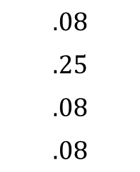



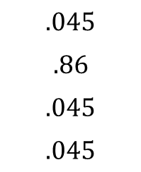

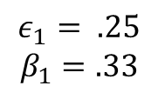
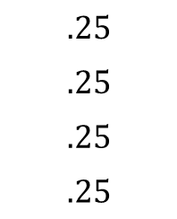



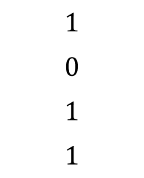
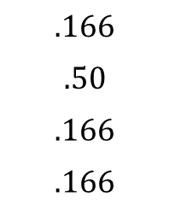
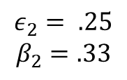

Example of boosting
$$S$$
$$p_{1}$$
$${h_{1}\left(i\right)= y}_{i}$$
$$w_{2}$$
$$p_{2}$$
$${h_{2}\left(i\right)= y}_{i}$$
$$w_{3}$$
$$p_{3}$$
$$<x_{1},y_{1}>$$
$$<x_{2},y_{2}>$$
$$<x_{3},y_{3}>$$
$$<x_{4},y_{4}>$$
$$.25$$
$$.25$$
$$.25$$
$.25$
$$1$$
$$0$$
$$1$$
$1$
$$.08$$
$$.25$$
$$.08$$
$.08$
$$.166$$
$$.50$$
$$.166$$
$.166$
$$1$$
$$0$$
$$1$$
$1$
$$.026$$
$$.50$$
$$.026$$
$.026$
$$.045$$
$$.86$$
$$.045$$
$.045$
$$h_{1}$$
$$h_{2}$$
E2 should be weighted?
$$ε_{1}= .25$$
$$β_{1}=.33$$
$$ε_{2}= .25$$
$$β_{2}=.33$$
All $y=1$
$$h\left(x_{new}\right)=1 if (\log{\frac{1}{β_{1}}}h_{1}\left(x_{new}\right)+\log{\frac{1}{β_{2}}h_{2}(x_{new}))> .5 else 0}$$
$$log⁡(\frac{1}{β_{r}})$$
$$β_{r}$$

Slide 10
Summary
Boosting is an ensemble technique where each base model learns a part of the concept
Boosting can allow weak (high bias) learners to learn complicated concepts
Boosting can help with bias or variance issues, but can overfit – need to control the search
A form of boosting – Gradient Boosting Machines (GBM) – is currently used when chasing high accuracy in practice

